Slide 1
Icons in the retail sector
A/P Medha Kudaisya

Slide 2
Outline
Retail in Singapore: Understanding the Retail Scene and its challenges
Case Study: Mohamed Mustafa & Samsudin Co Pte. Ltd
Early Years, 1950s-1970s
Expansion, 1970s
Regional Expansion
Diversification
Business Model and Market Niches
Challenges Mustafa faces
The Future of Retail?

Slide 3
Retail in Singapore
Retail in GDP and role in employment
Global collapse in retailing
Challenges which Retail faces
Retail in a constant state of renewal since the earliest days of commerce

Slide 4
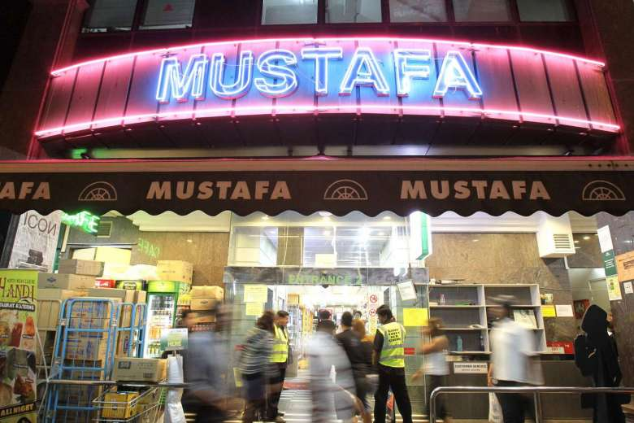
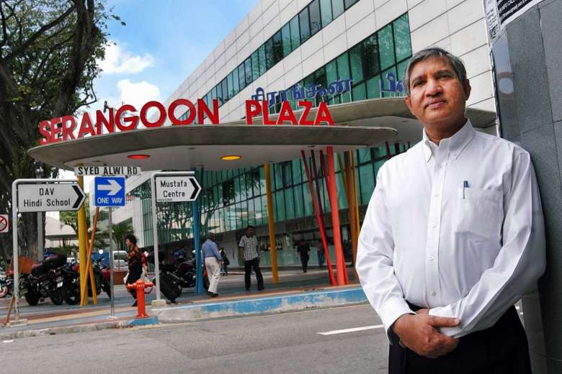
Mustafa : A Retail Icon

Slide 5
Early Years
Haji Mohamed Mustafa
1916–2001 Jaunpur, Uttar Pradesh
Samssuddin
Muar, Malaysia: peddling food
1952: Singapore
Mustaq Ahmad joined the firm
in 1956: food business
Handkerchiefs

Slide 6
Consolidation and Expansion Strategies
Entry into retail clothing 1965
Mohammed Mustafa & Samsuddin Co (MM & S) 1971: Campbell Lane (500 square feet space)
Move to Serangoon Road, 1973
New Interests

Slide 7
Expansion, 1980s onwards
Boom in Tourism, 1970s – 1980s
Recession of 1985: The turning point in policy towards Private Enterprise
New Policy towards SMEs
1985: Acquisition of the old store for conservation
1986: Move to new Premises
Mustafa acquires old shop houses
New Retail Space: 85,000 sq feet
130 room hotel
1996: Retail space expanded: 160,000 sq feet

Slide 8
1990s Retail Slump and its Impact
Retail Slump of mid 1990s
Limited Impact
1997: Extended Mustafa Centre – S$25 million

Slide 9
Regional Expansion and Retail Innovations
Chennai, 2000: Mustafa Goldmart
2003 Jakarta, Indonesia
2012 Bangladesh retail shop
2003: First retail shop to remain open 24/7
Targeting the South Asian Tourist
2004: Tourism Entrepreneur of the Year Award

Slide 10
Further Diversifications
Mustafa Hotel
Remittances business
Money transfer to over 1500 banks in India
Demand draft services across South Asia
Travel services
Services for Embassies since 2009

Slide 11
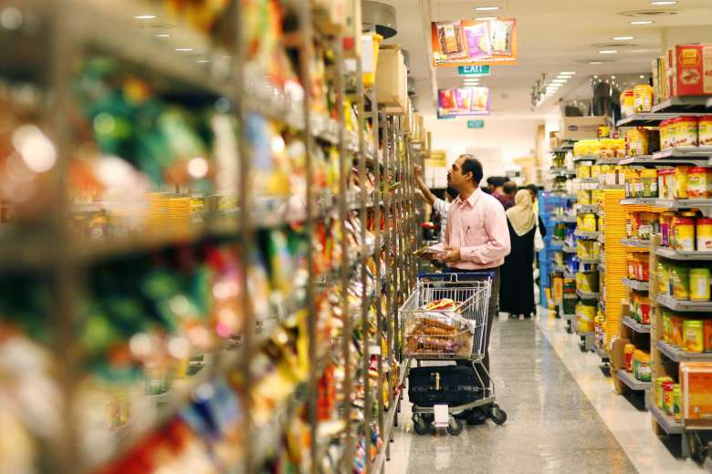
Business Model & Strategies (I)
Volume driven and cheaper, competitive, fixed prices
200,000 items; profit margin 10 to 15 per cent
Acquire premises rather than rent
Family Business

Slide 12
Business Model, Strategies & Challenges (II)
Targeting the South Asian Consumer (local and tourist)
Responding to Consumer Demands
- Mustaq: ‘We carry out consumer surveys regularly and try to find out what customers would like to have in our stores and we provide them at the best value’
Traditional Outlook: Minimum investment in display, advertisement
Acquire premisies rather than rent
- Mustaq: ‘Our other ideas may change, but we never change our motto to build and own’
Family business
Challenges Mustafa faces
Family feuds
Investigations over employment offences, fire safety regulations etc

Slide 13
The Challenges of Retail
Customer experience
Artificial intelligence
The rise of the conscious customer
The New Retail Landscape: Platform players Vs traditional retailers
Notes:
Customer experience is more important than ever as retailers are striving to differentiate themselves in a challenging and crowded market. Consequently, experience per square foot will be the new retail metric to measure success.
Artificial intelligence will gain more clout with some executives predicting that 85 percent of all transactions will be AI-based by 2020. 2018 will be the year we see AI being deployed at scale.
The rise of the conscious customer will continue as consumers base their buying decisions on many factors beyond price. These new consumers, led and influenced by millennials, are exerting influence on retailers and forcing them to take action.
The retail world we were promised is here and it will continue to impact the path to purchase. We've arrived at the intersection of elevated consumer expectations and technical possibility.
A tale of two hemispheres is playing out as platform players and non-traditional retailers expand their reach and offerings. The juxtaposition of what is happening in the West and the East will dominate the retail landscape with the latter in many cases moving faster than the former.

Slide 14
Thank you

